Slide 1
Low-Overhead
Occupancy Tracking
Hannah LaTourette
Master’s Project, Spring 2021
Dr. Koushik Kar, ECSE

Slide 2
Overview
Motivation and use cases
System requirements
Sensor specifications
Algorithm design
Software model
Demonstration & evaluation
Next steps

Slide 3
Problem Definition

Slide 4
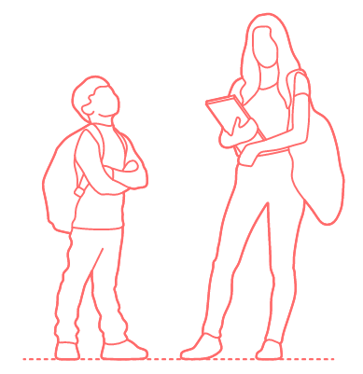
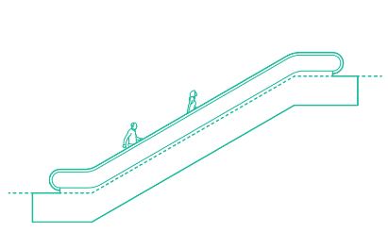
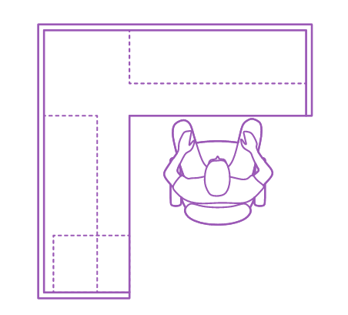
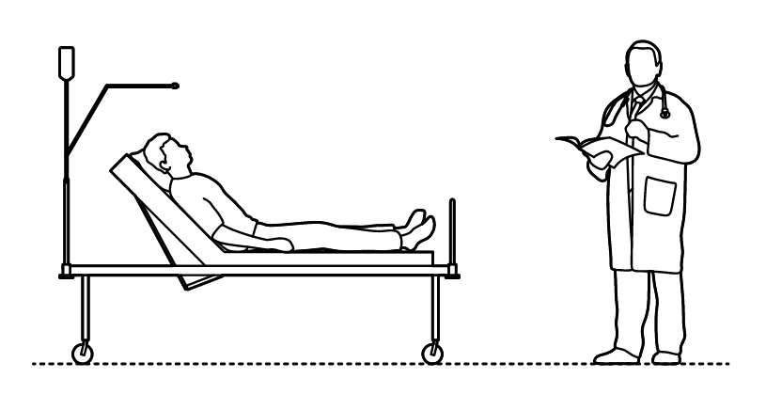
Use Cases
Universities: attendance, real lecture sizes, use of on-campus resources
Large office spaces: lighting and HVAC, emergency planning
Shopping malls: traffic patterns, rent prices, or food cart locations
Intrusion detection: alert when person is detected during the night, etc.
Social distancing: limit people in stores without repeated counting

Slide 5
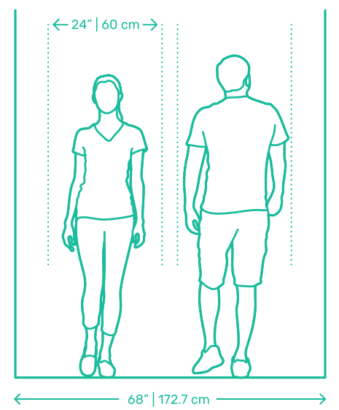
User Needs (Long-Term)
Need | Mall | University
Detection of multiple people walking together | <= 6 people | <=2 people
Detection of people walking through any part of corridor | <= 8 meters | <= 1.7 meters
Detection of people entering and exiting simultaneously | <= 3 per direction | N/A
Sensors which will last months to years | >= 1 year | >= 4 months or >= 8 months

Slide 6
Important cases to handle
Many people entering and exiting at once
Lingering in the doorway to chat
Walking parallel to doorway
Child-height tracking

Slide 7
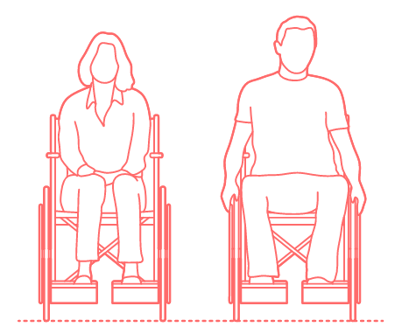
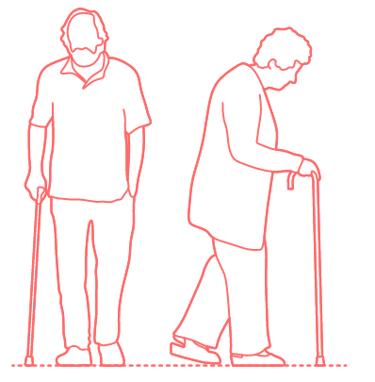
Additional considerations
Non-disruptive to those counted
Not a privacy concern for those counted (issue for RF or cameras)
Accessible (functional for people with wheelchairs, canes, etc.)

Slide 8
Solutions

Slide 9
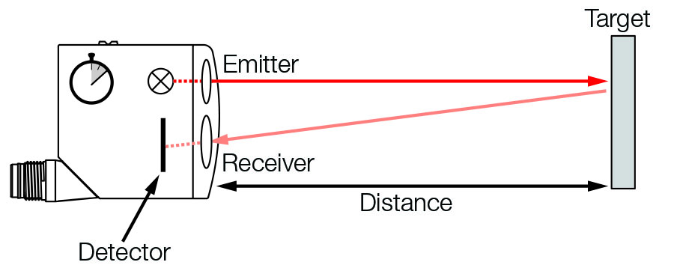
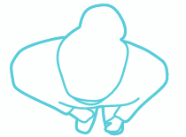
Initial solution | Thru-beam
If no object obstructs the path, the beam is reflected back to the sensor
If an object obstructs the path, the beam will not be reflected back
With two thru-beams, a person’s walking direction can be determined
Accessibility: polarized sensors emit filtered light and expect it back, so they are not fazed by metal objects

Slide 10
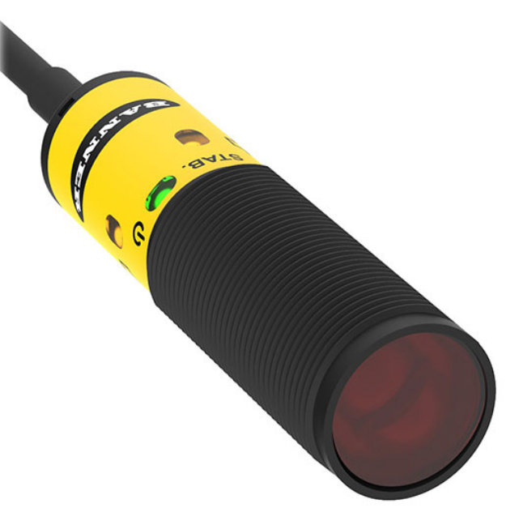
Chosen sensor | Thru-beam
Banner Engineering Corp. S18-2VNLP-2M
Polarized retroreflective thru-beam sensor
Sensing distance: 6 m
Power supply: 10-20 V
Communication: I2C
Response time: 1.5 ms

Slide 11
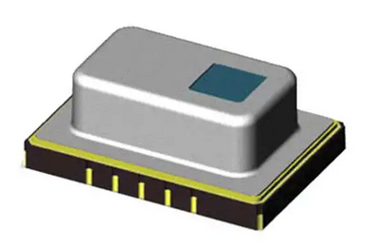
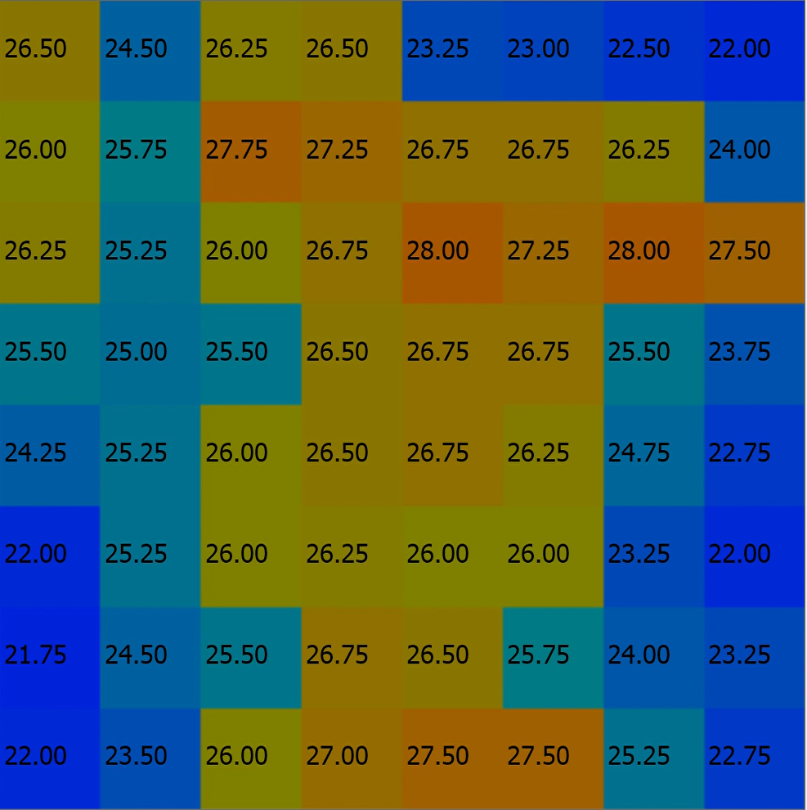
Chosen sensor | Coarse IR camera
Panasonic Grid-EYE AMG8854
64-pixel IR camera
Sensing distance: 7 m
Power supply: 5 V
Communication: I2C
Frame rate: 10 f/sec

Slide 12
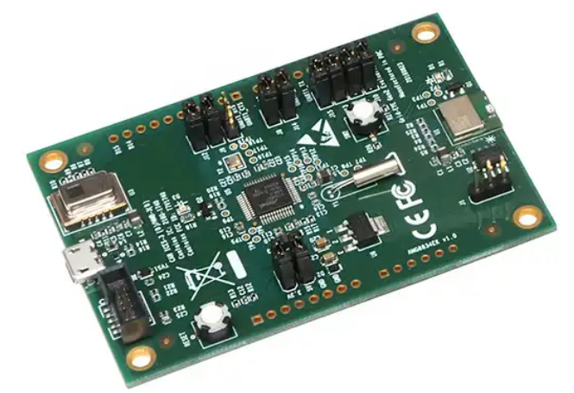
Grid-EYE Development Board
Panasonic Grid-EYE AMG8854 EVAL
64-pixel IR camera w/ development board
ATSAMD21G Microchip
Bluetooth module
Arduino header compatibility
JTAG port
Due to time and resource constraints introduced by COVID-19, this board was used to develop a preliminary model.

Slide 13
Project Basics

Slide 14
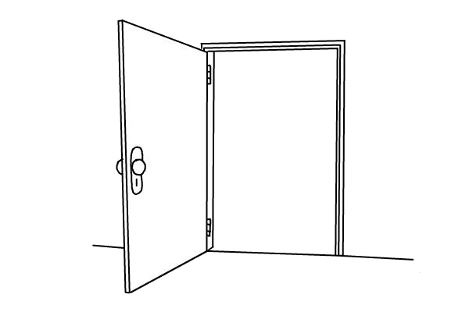
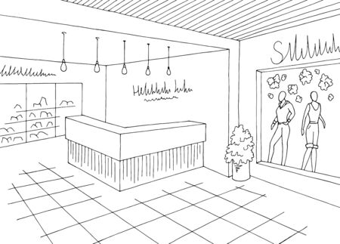
Physical setup
Spring 2020
Spring 2021
Single sensor placed on side of doorway, only suitable to count one person at a time
Multiple sensors placed on top or doorway or corridor, can count multiple entries / exits at once

Slide 15
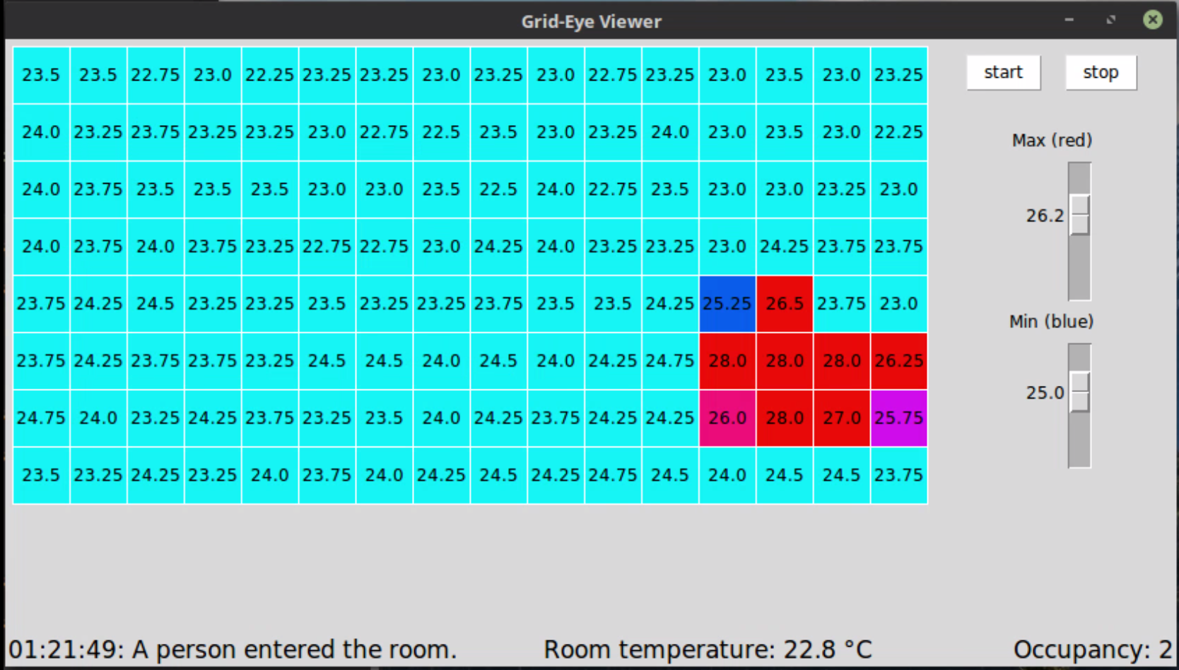
Application overview
Live color-coded grid showing current temperature values from sensors
Desktop program written in Python using:
TKinter
PySerial
NumPy
GridEyeKit (provided by Panasonic)
EvalKit (provided by A. Hoch)
Adjustable scrollbars to customize cutoffs for blue and red color displays
Dashboard showing most recent event, room temp, and current occupancy

Slide 16
Important cases to handle
Many people entering and exiting at once
Lingering in the doorway to chat
Walking parallel to doorway
Child-height tracking

Slide 17
Algorithm Features
Counting occupancy
Clearing correct flags
Accounting for overlapping columns

Slide 18
Counting occupancy
Threshold crossing
If a person passes through a doorway into a room, they will pass from the outside, through the middle, to the inside:
OUTSIDE
MIDDLE
DOORWAY
INSIDE
CURRENT OCCUPANCY: 0

Slide 19

Counting occupancy
Threshold crossing
If a person passes through a doorway into a room, they will pass from the outside, through the middle, to the inside:
CURRENT OCCUPANCY: 0

Slide 20
Counting occupancy
Threshold crossing
If a person passes through a doorway into a room, they will pass from the outside, through the middle, to the inside:
CURRENT OCCUPANCY: 0

Slide 21
Counting occupancy
Threshold crossing
If a person passes through a doorway into a room, they will pass from the outside, through the middle, to the inside:
If the outside, center, and inside flags are all set, a person must have entered the room. Clear all flags and increment current occupancy by 1.
CURRENT OCCUPANCY: 0

Slide 22
Counting occupancy
Threshold crossing
If a person passes through a doorway into a room, they will pass from the outside, through the middle, to the inside:
If the outside, center, and inside flags are all set, a person must have entered the room. Clear all flags and increment current occupancy by 1.
CURRENT OCCUPANCY: 1

Slide 23
Clearing flags
A person may set off heat flags in various columns during the walk across the threshold by entering at an angle, stumbling, avoiding others, etc.
Person A’s path set off a variety of flags in different columns
Goal: identify the clusters of flags from Person A and clear them all

Slide 24
Clearing flags
Clustering
Solution: Record the column which sets its inside, middle, and outside flags first. Clear flags on either side of these flags until you hit a cell without a flag.
Person A’s path set off a variety of flags in different columns

Slide 25
Clearing flags
Clustering
Solution: Record the column which sets its inside, middle, and outside flags first. Clear flags on either side of these flags until you hit a cell without a flag.
Person A’s path set off a variety of flags in different columns

Slide 26

Clearing flags
Clustering
Solution: Record the column which sets its inside, middle, and outside flags first. Clear flags on either side of these flags until you hit a cell without a flag.
Person A’s path set off a variety of flags in different columns
Correct flags cleared!

Slide 27

Clearing flags
Issues
In some corner cases, including a drastic angle of walking trajectory, this method does not clear the correct flags
An example with a different column being fully flagged first
Incorrect flags cleared!

Slide 28
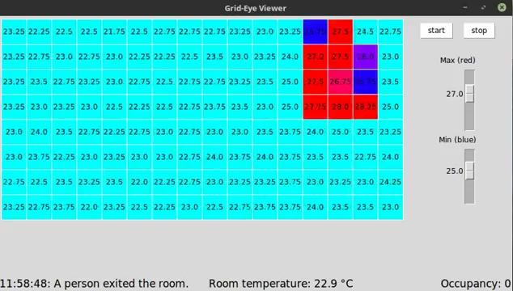
Clearing flags
Results
Before clearing out clusters
After clearing out clusters

Slide 29
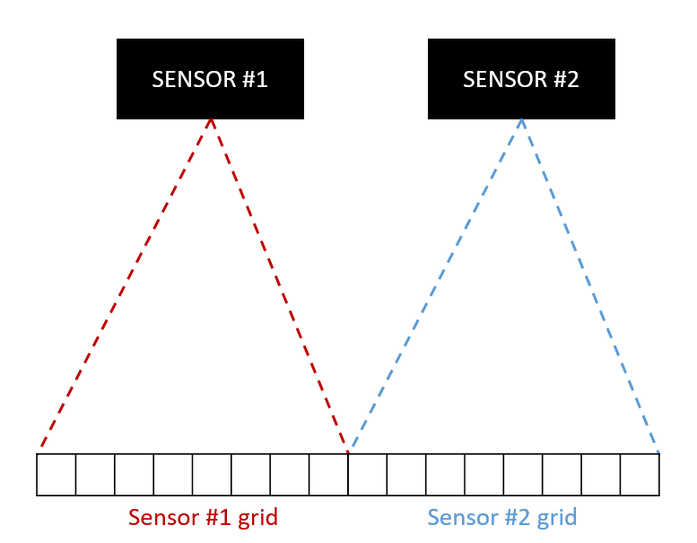
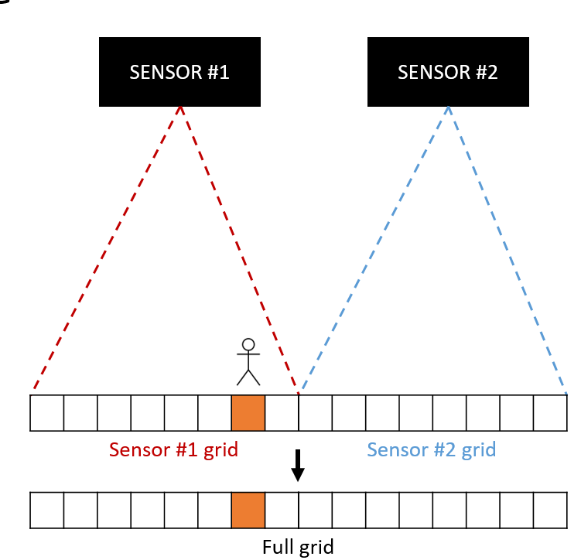
Overlapping readings
Ideal case
Ideally, we could space each sensor out perfectly so that one sensor’s view ends exactly where the next sensor’s view begins:

Slide 30
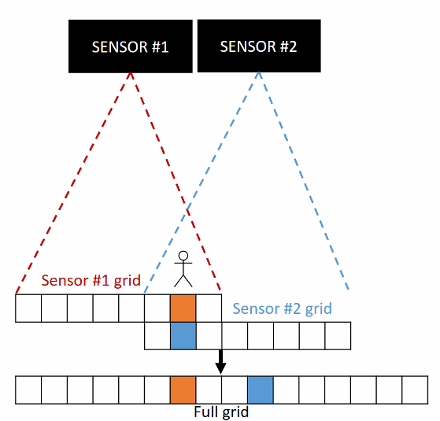
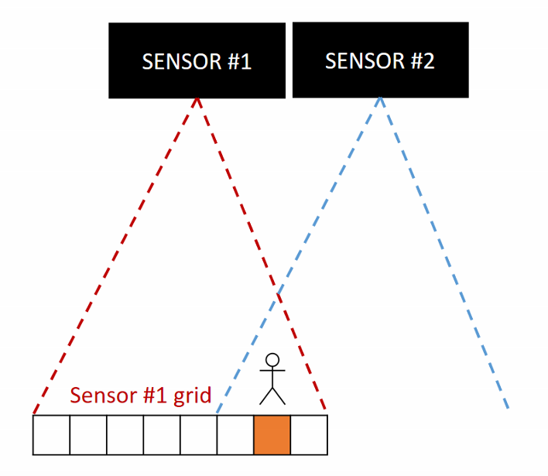
Overlapping readings
Real-life case
In reality, this can be difficult or impossible for many reasons (limited space, placement locations, slight movement over time, etc.):

Slide 31
Overlapping readings
Calibration
If we have columns which overlap, we can eliminate the mirror effect by combining the columns.
Replace them with the average of their two readings:

Slide 32
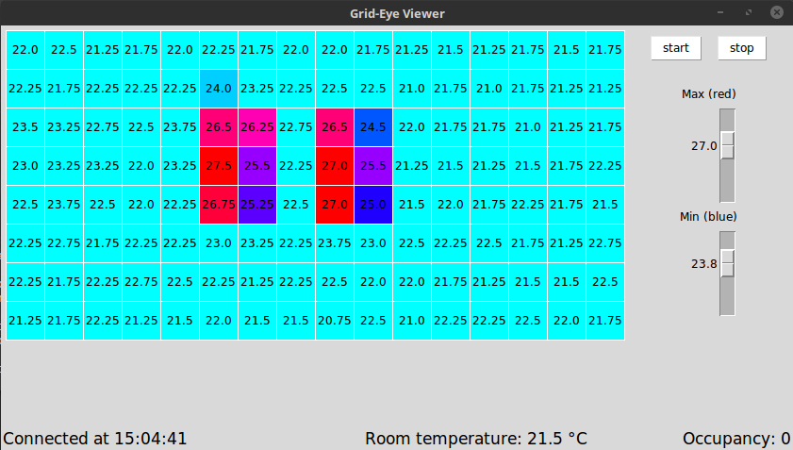
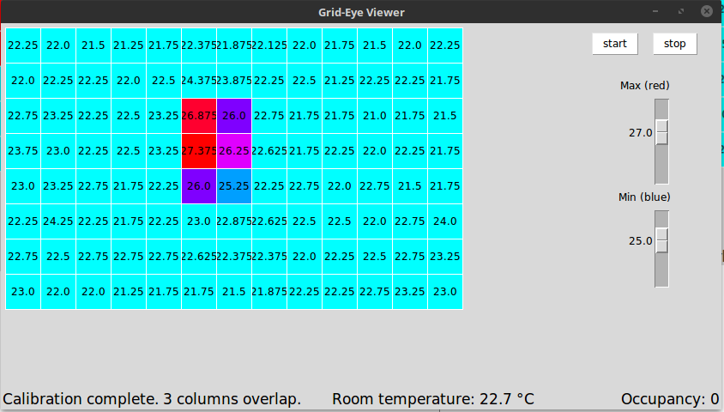
Overlapping readings
Results
Before calibrating to eliminate overlaps
After calibrating to eliminate overlaps

Slide 33
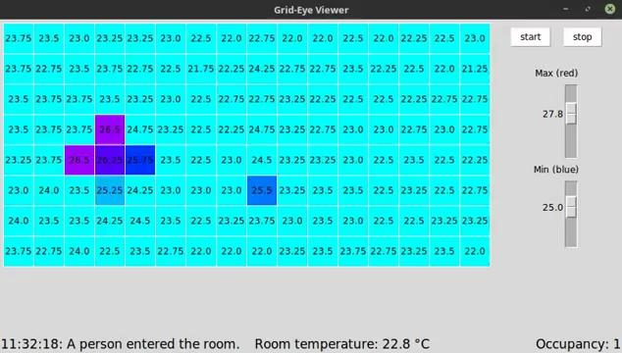
Overlapping readings
Results
Due to real-world conditions and a lack of symmetry, this solution is not perfect. The same object may be detectable in two columns, but the sensors will not read the same amount of heat from it, so the average isn’t always best.

Slide 34
Software overview

Slide 35
Software model | Class hierarchy
Class hierarchy, showing addition made to Grid-EYE reading and GUI software created by Alexander Hoch, which can be downloaded here.
GridEyeViewer
Creates GUI box, gets readings from GridEyeKit to update pixel colors
OccupancyTracker
Manages all sensors connected to system and uses algorithm to keep track of entries/exits
GridEyeKit
Class of tools for connecting to and reading GridEye data

Slide 36
Software model | High-level flow
High-level functionality map, showing addition made to Grid-EYE reading and GUI software created by Alexander Hoch, which can be downloaded here.
get_avg_tmp
Take 100 samples to find room temp
_get_GridEye_data
Read from sensor
update_tarrpixels
Update pixel colors on GUI
update_person_count
Check for humans and update status

Slide 37
Software model | High-level flow
High-level functionality map, showing addition made to Grid-EYE reading and GUI software created by Alexander Hoch, which can be downloaded here.
Try all available COM ports to connect to specified number of sensors
Get sensor readings, set heat flags and use threshold crossing to determine occupancy
If entry or exit, use clustering to clear appropriate flags
Calibrate to eliminate mirrored readings

Slide 38
Software model | update_person_count
Like the thru-beam sensor approach, the program uses the fact that 2 thresholds will be crossed when a person passes through a doorway:
If inside col is warm, set in flag
If outside flag is set, a person has entered. Decrement count
Evaluate reading by average heat in each column
Reset old flags if screen is cold (no people in view)
If outside col is warm, set out flag
If inside flag is set, a person has exited. Increment count
This functionality was implemented with a new OccupancyTracker class which was made an object of the EvalKit class from the original code

Slide 39
Results

Slide 40
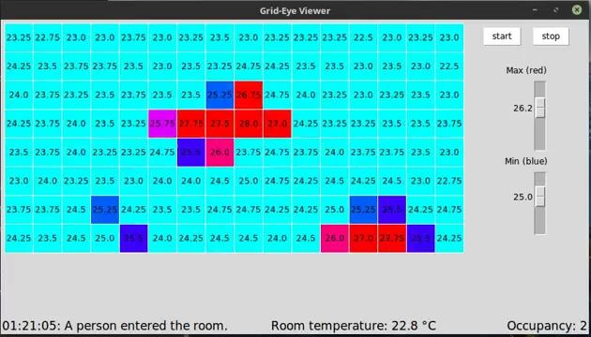
Final demonstration

Slide 41
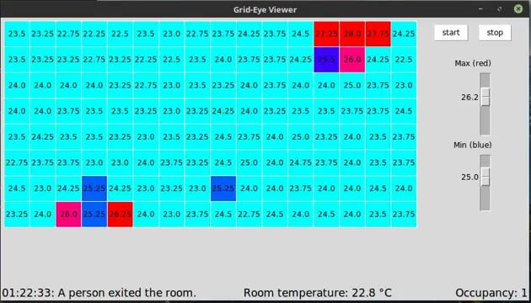
Final demonstration

Slide 42
Key contributions, Spring 2021
Integration of multiple sensors and corresponding GUI display
Dashboard which displays latest event, room temperature, and current occupancy to user at all time
Two-dimensional heat flag array which allows for detection of the entry and exit of multiple people at once
Effective handling for known overlapping columns
Cluster detection which ensures appropriate flags are cleared when a person has passed the threshold (works outside of certain corner cases)
Automatic detection of overlapping columns (somewhat work in progress)

Slide 43
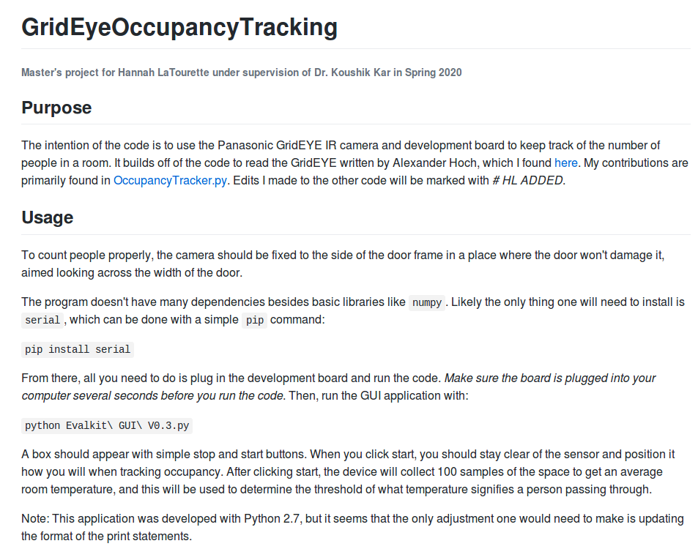
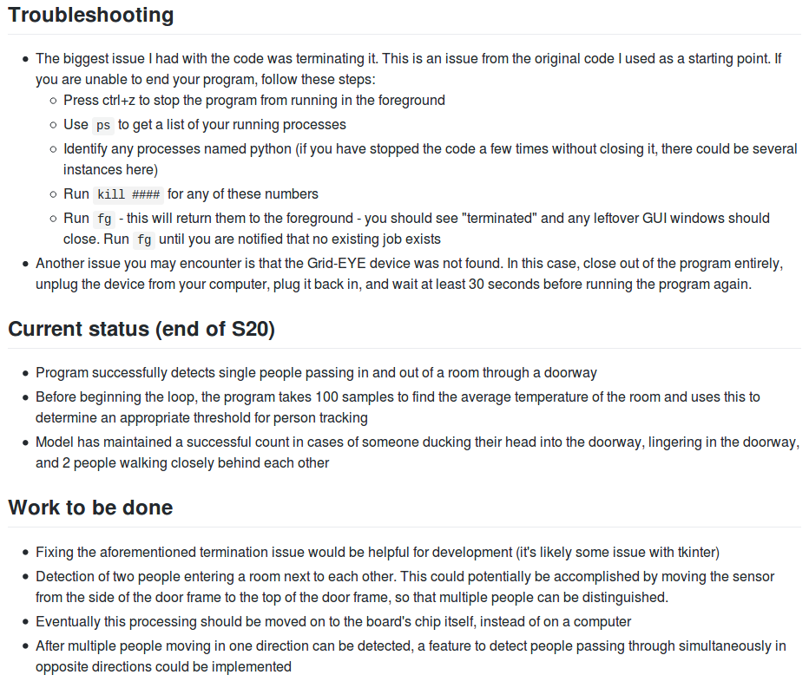
Documentation
Project available on Github at https://github.com/hannahlatourette/GridEyeOccupancyTracking

Slide 44
Next steps
More proficient overlapping detection
On-chip analysis & Bluetooth integration
Student will work over the summer on GUI updates (manual occupancy reset, push notifications, etc.)
Bluetooth communication in sensors may be incorporated into future labs for ECSE 4660/6660 Internetworking of Things
When students can return to campus labs, a solution using thru-beam sensors may also be investigated and implemented

Slide 45
References
Corridor & Hallway Dimension | Dimension Guide
The Important Factors of Corridors Settings in Shopping Center Design | A. Kusumowidagdo
Reducing Battery Consumption | Temboo

Slide 46
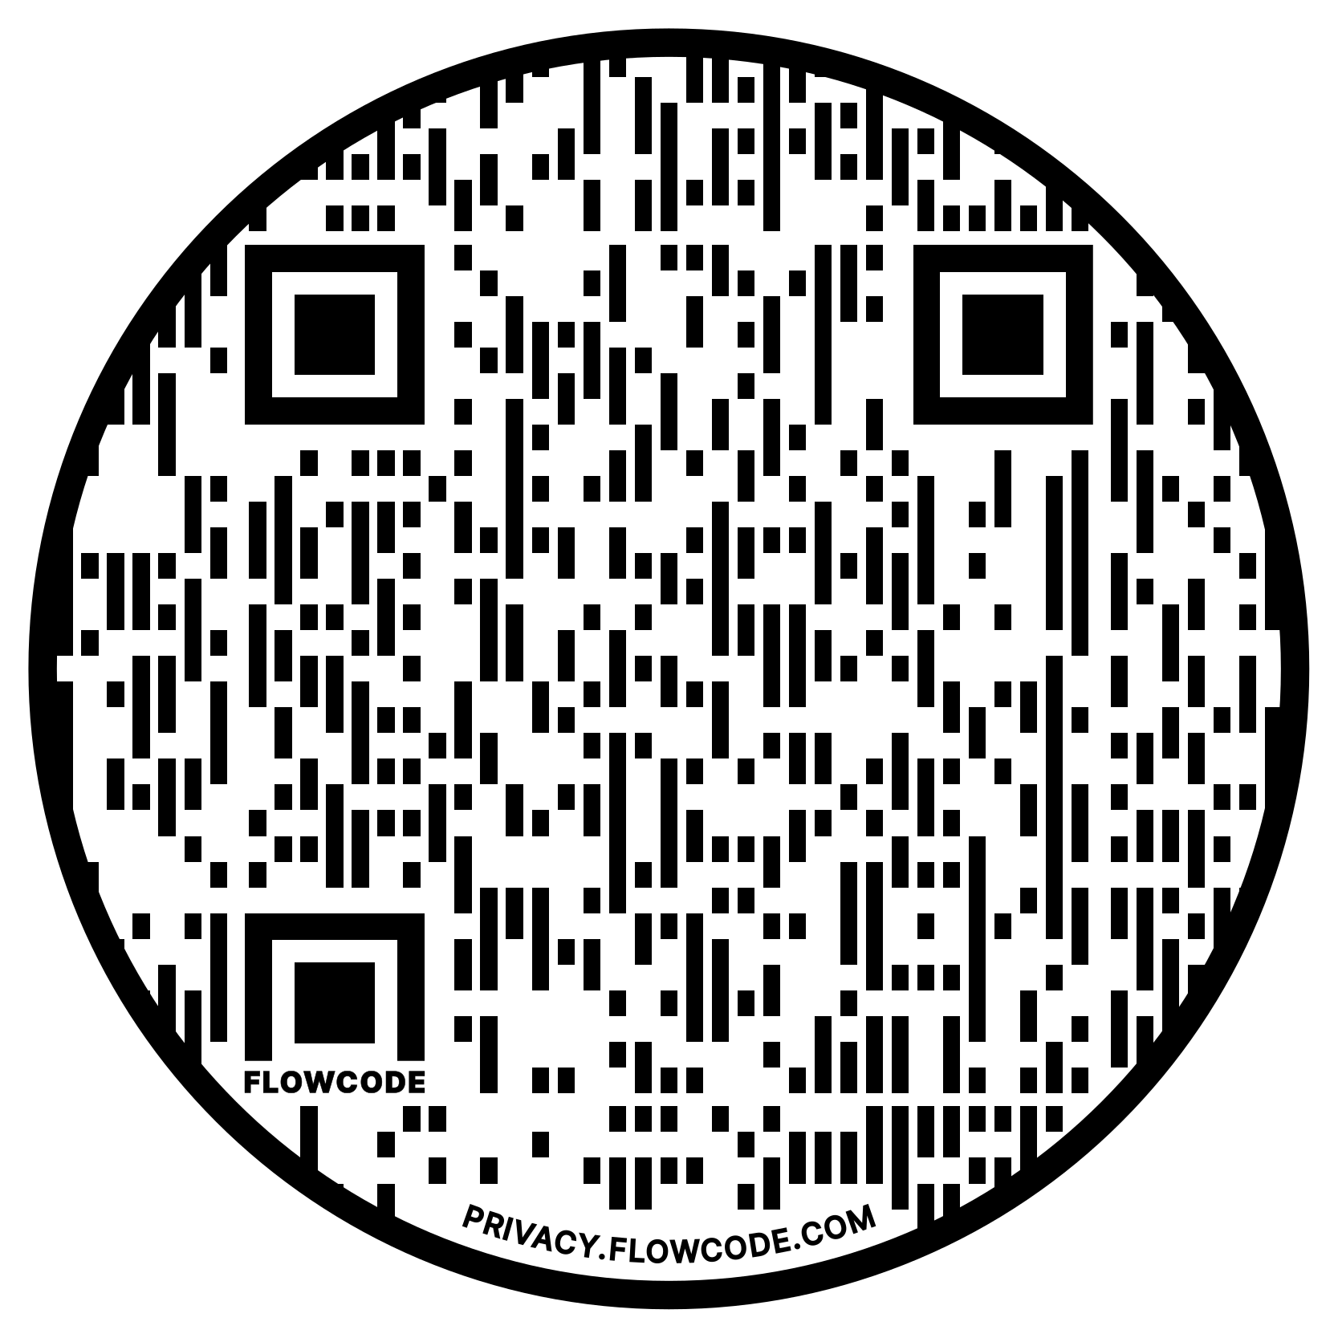
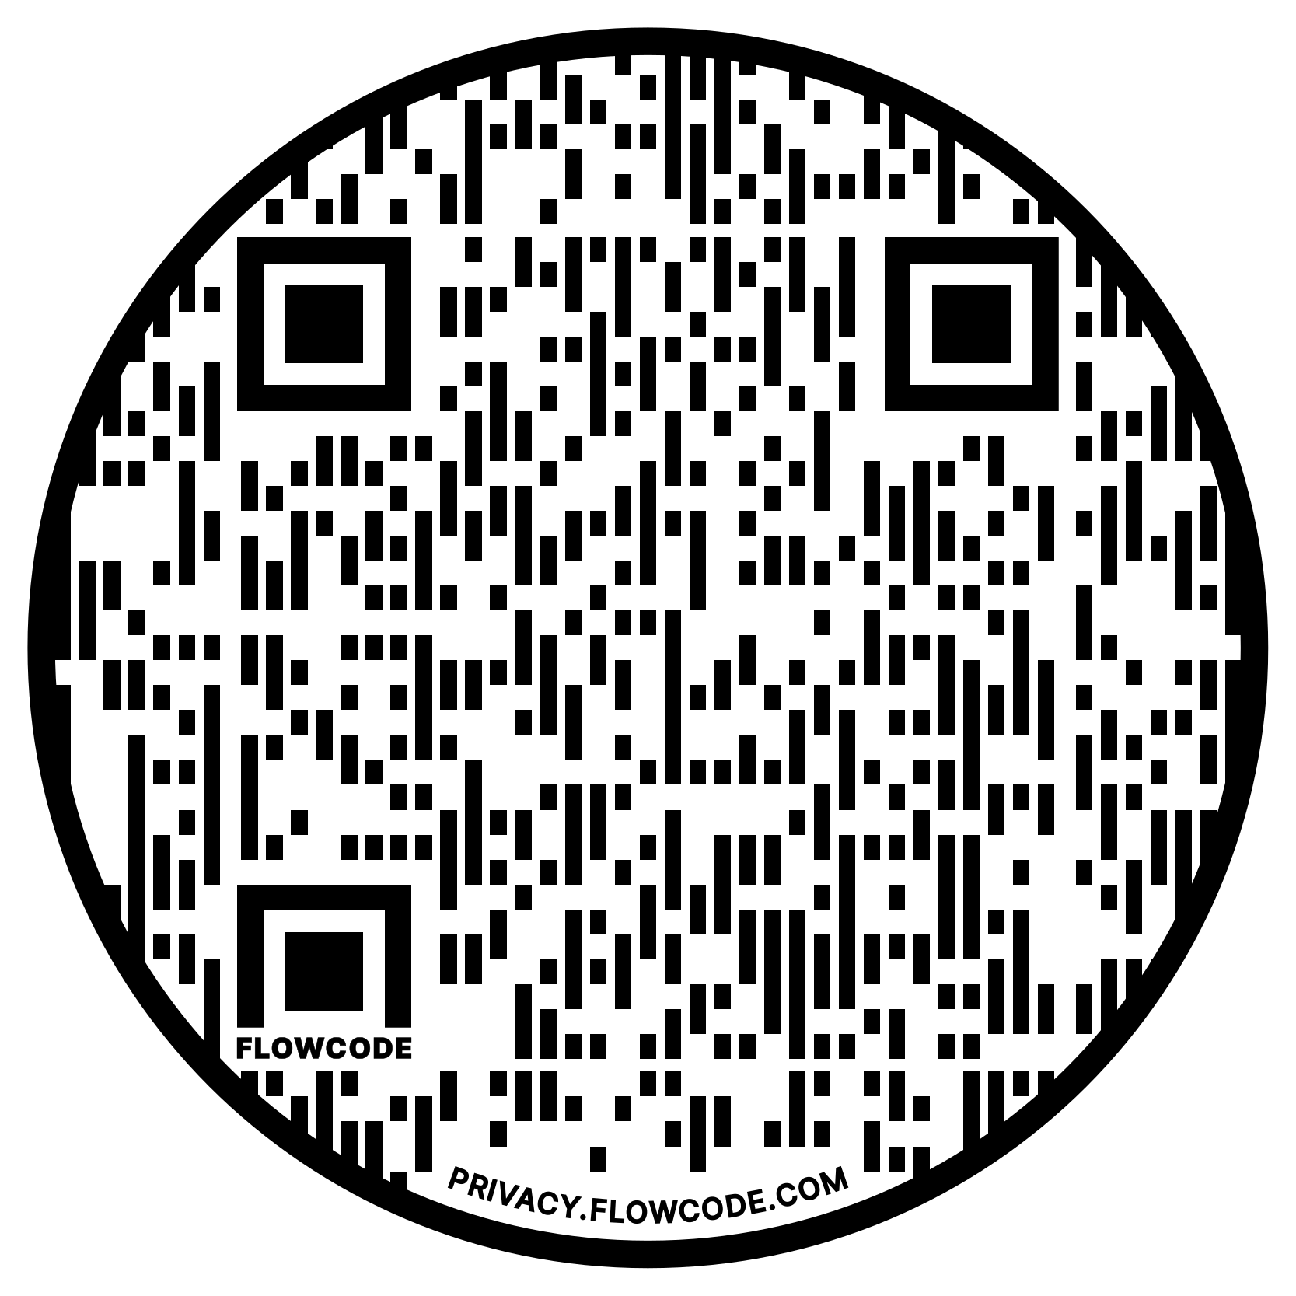
Links
Github page with source code and documentation
These presentation slides

Slide 47
Thank you!
Questions?

